Slide 1
Coursera Capstone Project
Sanya Srivastava

Slide 2
INTRO
Steak is a popular meat that is consumed in Sydney, Australia. However, in recent years, the popularity of beef is declining.
The consumption of meat has declined in Australia due to the lack of Steakhouses in the Sydney area. Opening a steakhouse can increase the consumption of beef in the future.
The objective of this capstone project is to find an area in Sydney, Australia to open a new Steakhouse. Using data science skills, we answer the question: In the city of Sydney, Australia, if a steakhouse restaurant owner wants to open a restaurant, where would you recommend opening it?

Slide 3
DATA
To solve the problem, we will need the following data:
List of neighborhoods in Sydney, Australia.
Longitude and latitude coordinates of the neighborhoods.
Venue data
Source of data and methods to extract them
The Wikipedia page (https://en.wikipedia.org/wiki/Category:Suburbs_of_Sydney) contains a list of neighborhoods in Sydney, Australia with 200 neighborhoods.

Slide 4
METHODS
Used k-means clustering on the data I have acquired. I used this machine learning algorithm because it is one of the algorithms that is the easiest to use in a mapping situation. I used 3 clusters based on the “Steakhouse” amount in Sydney, Australia. Based on how many steakhouses there are in different neighborhoods, I could see what cluster needs a new or new steakhouse.

Slide 5
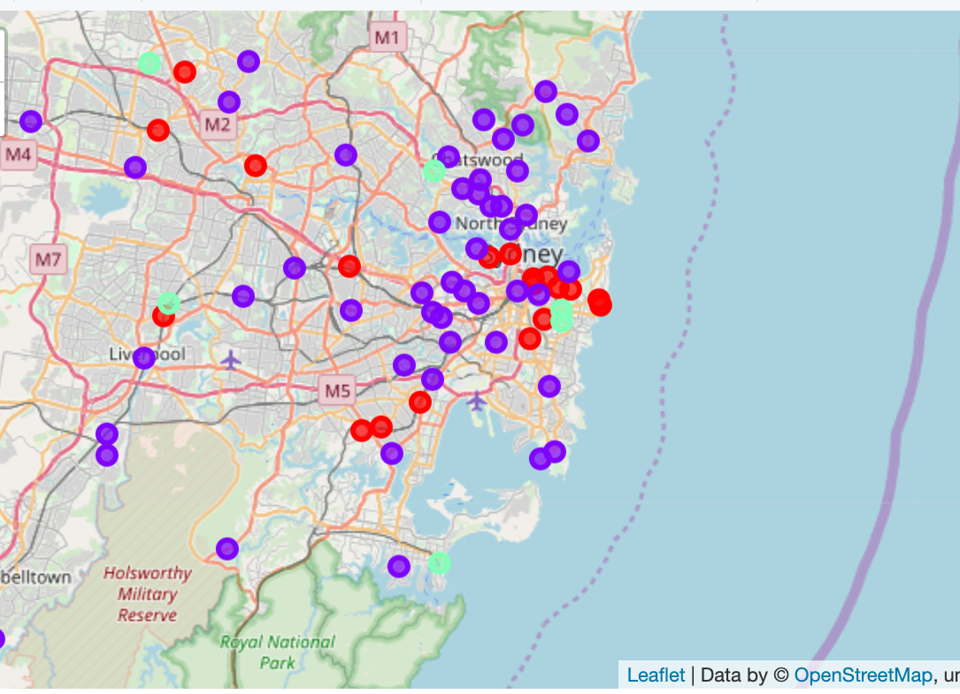
RESULTS
The results for the k-means clustering algorithm on the “Steakhouses” in Sydney, Australia shows three clusters based on this specific venue frequency:
Cluster 0: Low number of steakhouses.
Cluster 1: Low number of steakhouses
Cluster 2: High number of steakhouses
Below us a folium map that shows the cluster of steakhouses in neighborhoods.

Slide 6
DISCUSSION
Clusters 1 and cluster 0 have low amount of competition for Steakhouses, therefore it will be beneficial for a new steakhouse to be located in cluster 1 and cluster 0.

Slide 7
CONCLUSION
I found that clusters 1 and 0 should have the next steakhouse to profit and be successful in Sydney, Australia.
This project focuses on building a new steakhouse restaurant in Sydney, Australia to expand the beef market in Australia.

